Slide 1



Fault Diagnosis of Discrete-Event Systems
Alejandro White, Doctoral Candidate
Advisor: Dr. Karimoddini

Slide 2
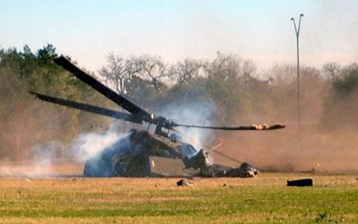
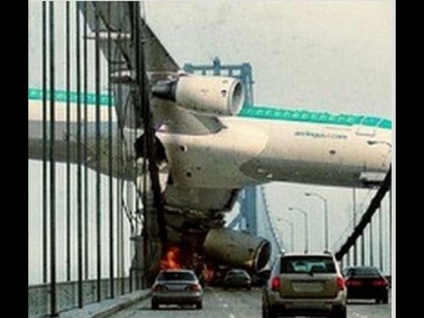
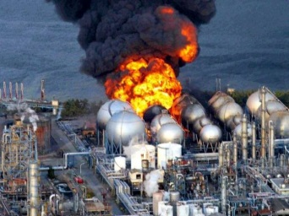
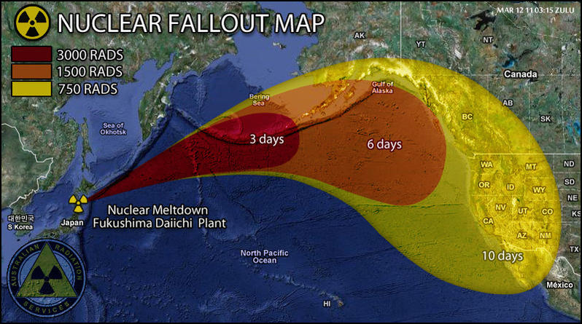
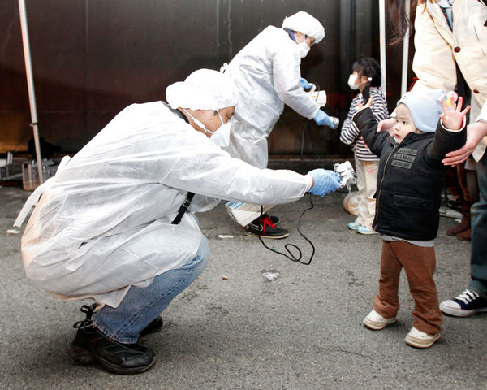
Motivation
Faults are always
Faults are unwanted
Faults are arbitrary
Faults are costly
Faults are DEADLY
Our motivation for the provision of fault diagnostics
is simple: we wish to minimize an everlasting,
unpredictable, life destroying entity.

Slide 3
TECHLAV Project
Testing, Evaluation and Control of Heterogeneous Large-scale Autonomous systems of Vehicles (TECHLAV)​
Thrust 2: Resilient Control and Communication of Large-scale Autonomous Vehicle
Task 2-1: Develop fault detection and isolation mechanism

Slide 4
TECHLAV Project
Objective
Impact
Upon a fault occurrence, a system will autonomously become aware of the fault’s occurrence, and initiate a systematic procedure that isolates, identifies, and accommodates the fault in order to ensure proper utilization of the system’s remaining resources, allowing a resilient post fault system operation that is both safe and stable.
To develop techniques for automatic diagnosis of failures in the system to timely diagnose (detect, identify and locate) occurred.

Slide 5
Outline
Definition of Fault
Definition of Fault Diagnosis
Survey of Methods of Fault Diagnosis
Formulation of Fault Diagnosis within Discrete-Event System
Constructing the Diagnoser
Diagnosability Condition
Future Work

Slide 6
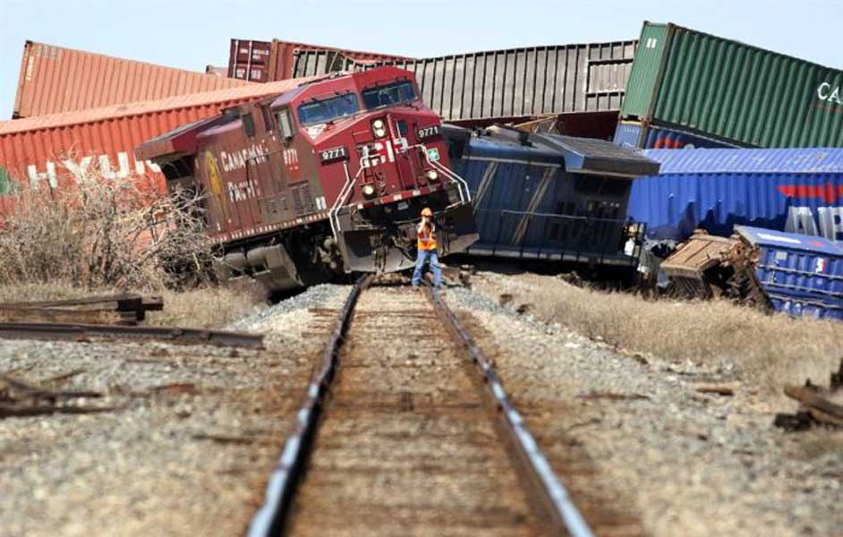
What is fault?
Fault - a malfunction in system component(s) (actuators, sensors,…etc.) that results in unacceptable system performance, and/or system instability

Slide 7


Fault Diagnosis
Fault Diagnosis - the detection of a fault’s occurrence conjoined with the identification of a fault’s nature, through examination of a system’s symptoms
Fault detection: If a fault has occurred?
Fault identification: What is the type and nature of failure?
Fault isolation: Where in the system has occurred?
Why do we need Fault Diagnosis?
To better accommodate system behavior post fault occurrence
Ensures system stability
Increases system reliability
Reduce number of failed missions
Save lives

Slide 8
State of the Art
Analytical Model Based: modelled system operation is compared to observed system operation
Residuals - comparison of observed signals from the system with predicted values; residuals are usually designed to be zero if not fault present (Frank & Ding, 1997; Roth et al., 2011)
Templates – specify the expected correct timing and sequencing of events (Holloway & Chand, 1994)
Fault free - observed system operation is compared to a nominal fault-free model (Pandalai & Holloway, 2000)
Non-Model Based: a single abstract representation encompassing normal and faulty system operation is analyzed
State based - system condition (failure status) is determined by state or set of states the system belongs to (Lin, 1993; Zad et al., 2003)
Event based - system failure determined by observance of sequences of events (Sampath et al., 1995)
Fault tree - fault diagnosis method based upon deductive fault analysis (Vesely et al., 1981; Lee et al., 1985)
Knowledge Based: heuristic
Expert system - past knowledge obtained by experts used to model unknown system aspects (Scherer & White, 1989; Handelman & Stengel 1989)
Artificial Neural Network - an abstract model of the brain’s neural pathways designed to actively “learn” the normal and faulty behavior of a system (Elias Kosmatopoulos & Polycarpou, 1995; Diao & Passino, 2001)

Slide 9
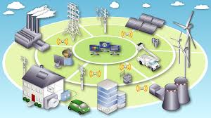
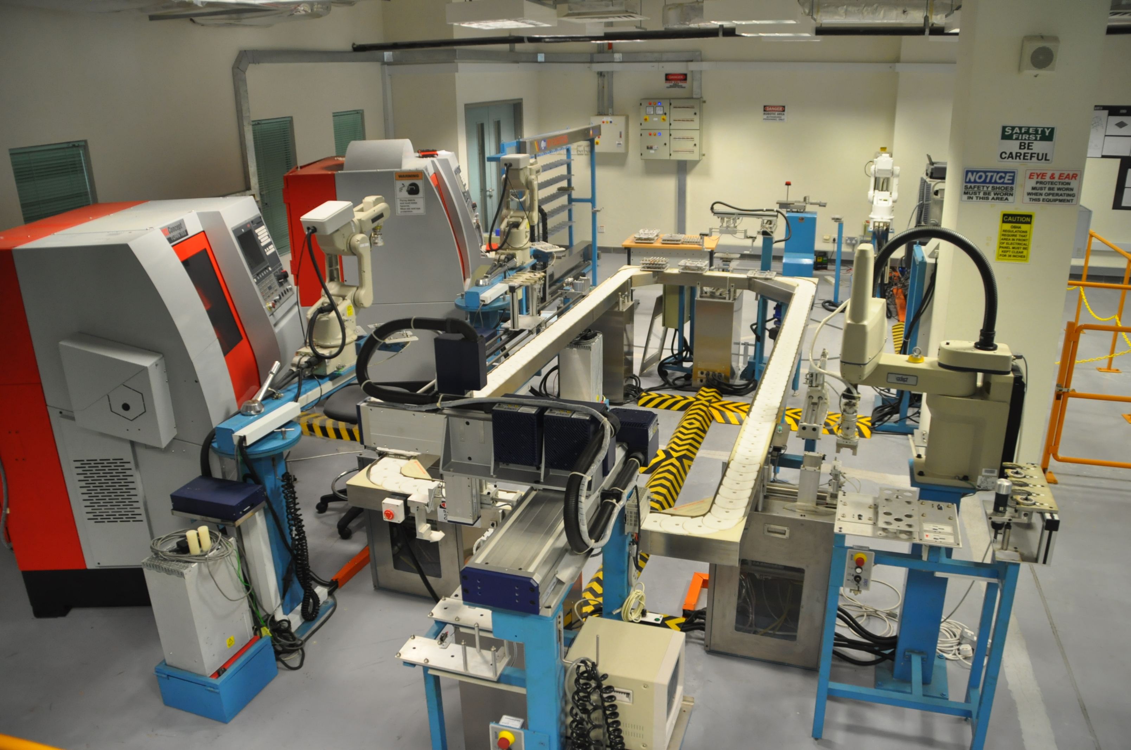
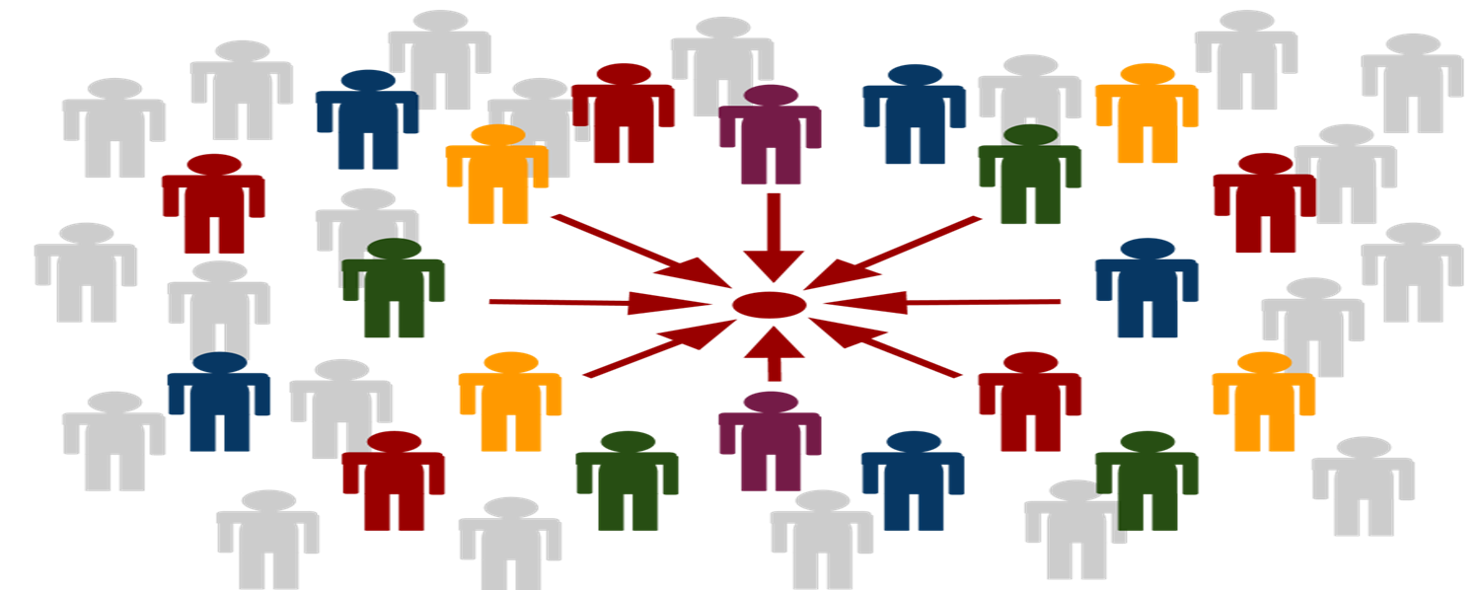

Why Discrete Event System Framework?
DES is an Event-driven time abstract formalism suitable for large-scale complex systems
For diagnostic purposes, several large and complex real-world systems are successfully modeled as Discrete-Event Systems (e.g., cyber networks, manufacturing systems, smart grids)
Naturally captures faults as abrupt changes (e.g., sequence of events)
Matches human thinking
coordination (e.g., interactions of systems) group
cause and effect (e.g., a fault causing event sequence)

Slide 10
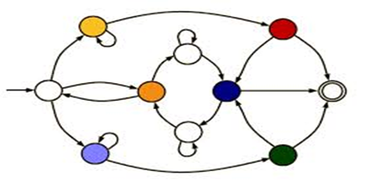
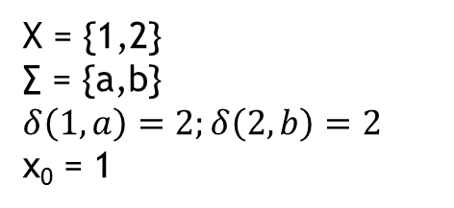
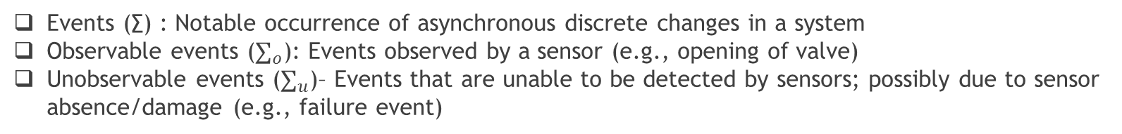
Automaton
Definition: a non-deterministic finite-state Discrete-Event System (DES) can be represented by a four-tuple
State space:
Event set:
State-transition relation: a partial relation that determines all feasible system state transitions caused by system events
Initial state:
.
Events (∑) : Notable occurrence of asynchronous discrete changes in a system
Observable events ($∑_{o}$): Events observed by a sensor (e.g., opening of valve)
Unobservable events ($∑_{u}$)– Events that are unable to be detected by sensors; possibly due to sensor absence/damage (e.g., failure event)
Am illustrative Example:
b
1
a
2
X = {1,2}
∑ = {a,b}
$$δ\left(1,a\right)=2;δ\left(2,b\right)=2$$
x₀ = 1

Slide 11
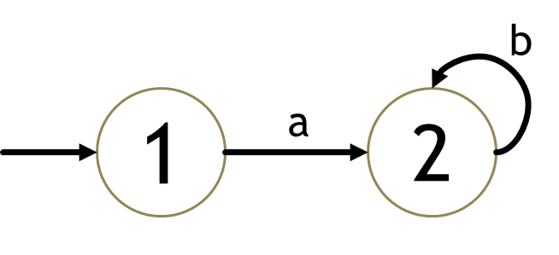
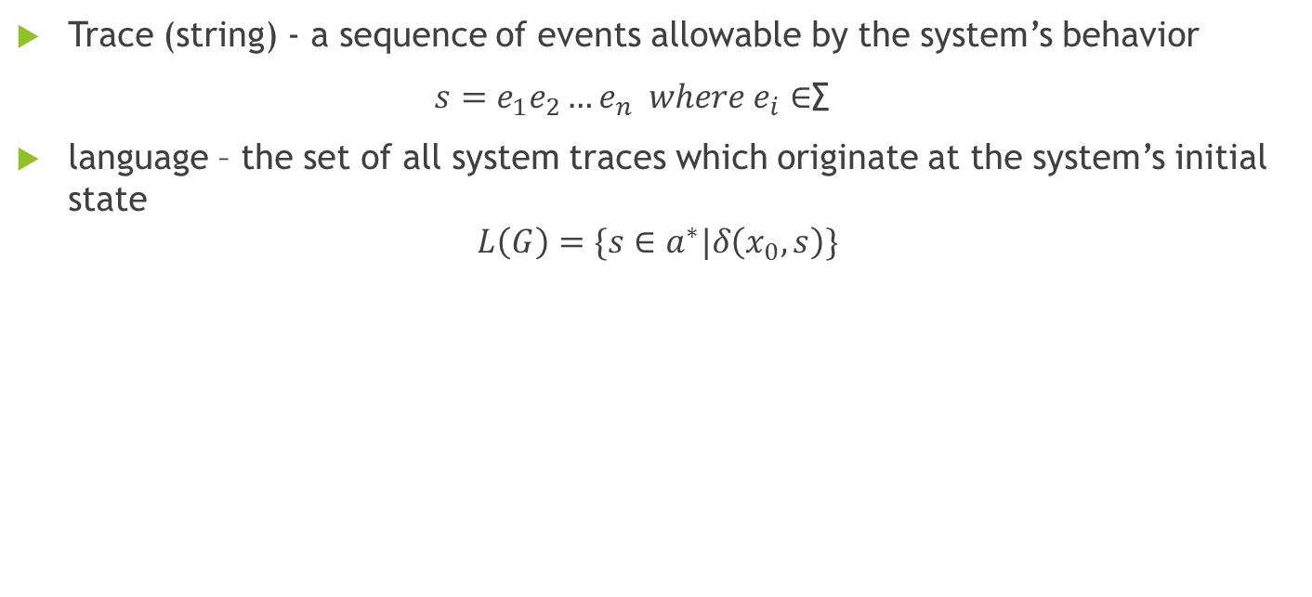
Language
Definition: the system language is a discrete representation of the system’s behaviors (normal and faulty) in the form of sequences of events
Trace (string) - a sequence of events allowable by the system’s behavior
$s=e_{1}e_{2}…e_{n} where e_{i}∈$∑
language – the set of all system traces which originate at the system’s initial state
$$L\left(G\right)=\{s∈a^{∗}|δ\left(x_{0},s\right)\}$$
Example:
∑= {a,b}
L ={a, ab*}

Slide 12

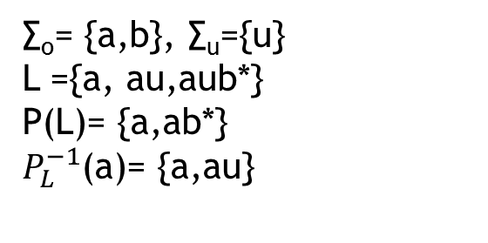
Natural Projection
Our purpose is to diagnose unobservable faults from the observable behavior of the system.
The system’s observable behavior can be described by the natural projection of the system’s language to the observable event set of the system.
Am illustrative Example:
b
1
a
2
u
3
b
Extension of the natural projection to the languages:
∑= {a,b,u}
∑_{o}= {a,b}, ∑_{u}={u}
L ={a, au,aub*}
P(L)= {a,ab*}
$P_{L}^{−1}$(a)= {a,au}
Inverse of natural projection

Slide 13
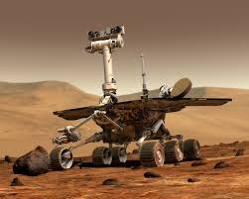
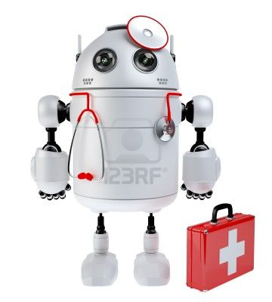
Diagnosis within DES Framework
Natural Projection
Plant
Diagnoser
Detected failures
Type of detected failures
Location of the system at detection time
How the diagnoser works?
The diagnoser provides fault diagnostics by extracting information from the original system’s observable behaviors, in order to estimate the original system’s current state and current condition (faulty or non-faulty).
The diagnoser’s state transition rule is only defined over the original system’s observable events.
Upon observance of the original system’s behavior, the diagnoser updates its estimation of the original system’s state and condition.

Slide 14
Assumptions
Faults are unobservable
Otherwise their detection would be trivial.
Understudied Faults do not bring the system to the halt mode.
This gives us enough time to diagnose the fault.
No arbitrarily long strings of unobservable events.
This ensures that following the occurrence of an unobservable, sooner or later the system will produce an observable event. This is needed for detection of an unobservable event
Live Language: state transition relation is defined for at least one event at all system states
This is to ensure that in the future the system will always produce a string of observable event to be used for diagnosis.

Slide 15
Capturing different types of faults
Different faults may result in the same failure results.
Example: An open circuit and a stuck closed valve may result in equivalent sensor reading.
We can partition the failure event set into m disjoint subset, each representing a failure type

Slide 16
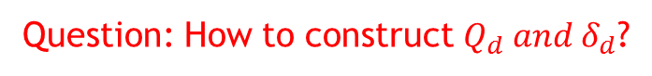
Diagnoser
Plant
Natural Projection
Diagnoser
Label propagation mechanism:
Question: How to construct $Q_{d} and δ_{d}$?

Slide 17
Constructing the diagnoser
b
b
1
a
2
f₁
3
Algorithm
a
b
a
4
f₂
5
a
{1N}
a
{2N,3F1,4N,5F2}
b
{1N,3F1,4F2,5F2}
a
b
{5F2}
b
{3F1,4F2,5F2}
a
b
a

Slide 18
Diagnosability
Question: An important question is that whether the diagnoser can detect and locate the failure?
Diagnosability - a system fault is considered diagnosable if upon its occurrence, all possible consequential system behaviors allow for the definitive diagnosis (detection, isolation, identification) of its occurrence.
A Diagnosable plant
An undiagnosable plant
b
b
b
b
1
a
2
f₁
3
1
a
2
f₁
3
a
a
b
a
a
4
f₂
5
4
f₂
5
Question: How to check it based on the structure of the diagnoser?

Slide 19
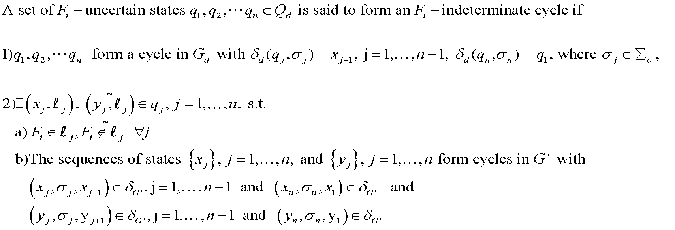
Checking the diagnosability based the structure of the diagnoser
Definition: Fi – Indeterminate Cycle:
Theorem: A language L without multiple failures of the same type is diagnosable, if and only if its diagnoser G_{d} has no F_{i} indeterminate cycle, for all failure types F_{i}, i=1,…,m

Slide 20
Example
F_{i} indeterminate Cycle
b
b
a
1
a
2
f₁
3
{1N}
a
{2N,3F1,4N,5F2}
b
{1N,3F1,4F2,5F2}
a
a
b
b
a
b
4
f₂
5
{5F2}
{3F1,4F2,5F2}
a
b
a

Slide 21
Gaps
In the existing methods (including the method presented here), it is required to initialize and run the diagnoser synchronously with the plant. This allows the diagnoser to diagnose failures based on a rich set of information including both pre- and post-failure behaviours in the system.
Challenges:
1- In many practical situations, only after a fault occurs, the diagnosis tool (e.g. a portable industrial computer) has to be brought and connected to the faulty plant to diagnose the occurred fault. In many cases, it is not possible, or it is time-consuming and costly, to restart the plant to be synchronized with the diagnoser.
2- Even if the plant and the diagnoser are initialized simultaneously, it is possible that for any particular reason, the diagnoser misses an observation, and thereafter, it cannot track the plant, in turn requiring both the plant and the diagnoser to be restarted again.

Slide 22

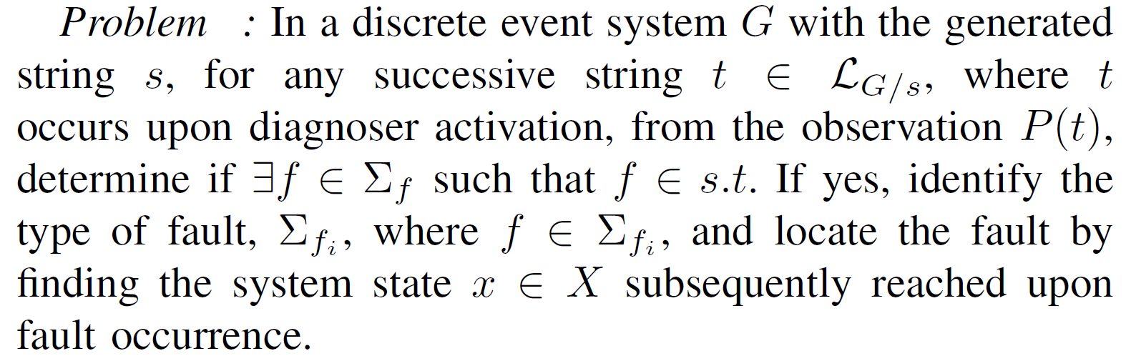
Future work
Asynchronous Fault Diagnosis: To develop a systematic and analytical approach to construct a diagnoser that can be asynchronously turned on at anytime, even after the occurrence of a fault.
Problem formulation:
Challenges:
1- Unlike conventional diagnosis techniques, the past history of the system before the activation of the diagnoser is not available, leaving the diagnoser with the challenge of diagnosing faults using only the future behaviors of the plant, observed after the activation
of the diagnoser.
2-In contrast to existing methods, where the initial state of the system and correspondingly the initial state of the diagnoser are generally assumed to be non-faulty, upon its initialization, the asynchronous diagnoser is no longer able to assume that the current state of the system is normal.

Slide 23

Acknowledgement
My colleagues at ACCESS LAB and TECHLAV Center
Financial support from TECHLAV project

Slide 24


